Slide 1
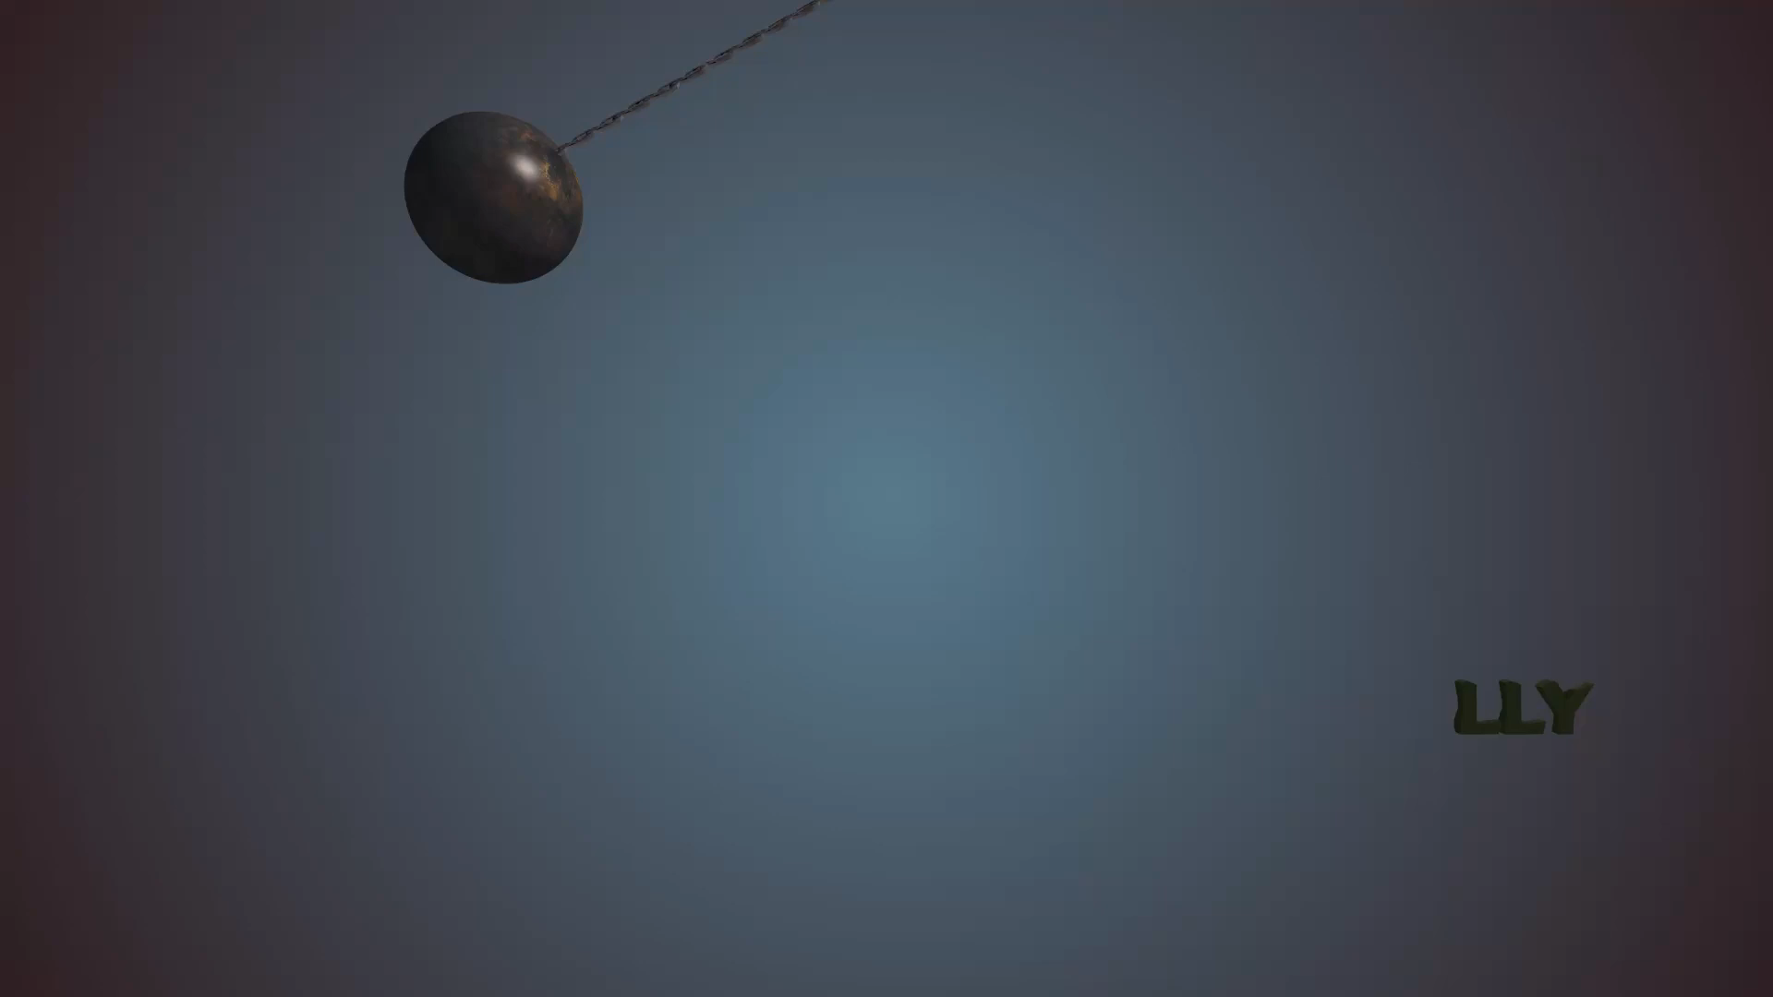
PROFESSOR:
Leonardo Lanari
SUPERVISOR:
Tommaso Belvedere
STUDENTS:
Anna Fumagalli
Catia Romaniello
Vincenzo Maria Vitale

Slide 2

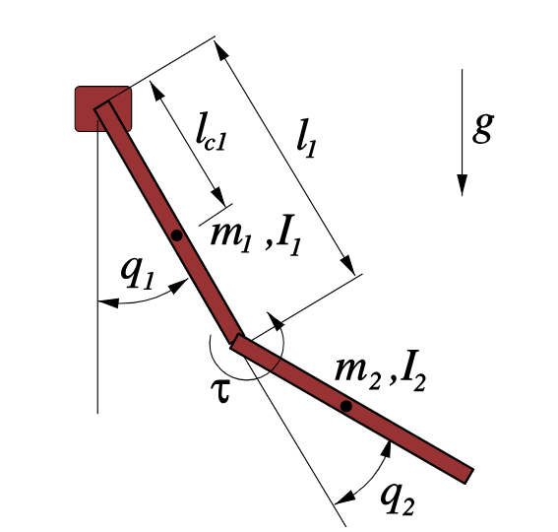
PROJECT PURPOSE:
Find an optimal trajectory for the swing-up of an acrobot.
INTRODUCTION

Slide 3

OVERVIEW:
Acrobot definition through an .urdf file
PyBullet simulator
Iterative Linear Quadratic Regulator (iLQR)
INTRODUCTION

Slide 4
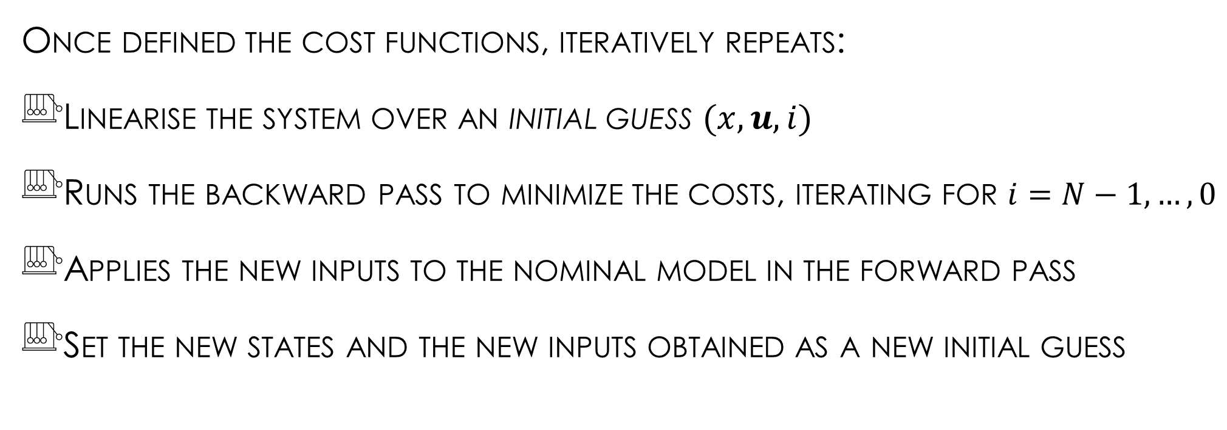
ITERATIVE LINEAR QUADRATIC OPTIMIZER
Once defined the cost functions, iteratively repeats:
Linearise the system over an initial guess $(x, u, i)$
Runs the backward pass to minimize the costs, iterating for $i=N−1,…, 0$
Applies the new inputs to the nominal model in the forward pass
Set the new states and the new inputs obtained as a new initial guess

Slide 5
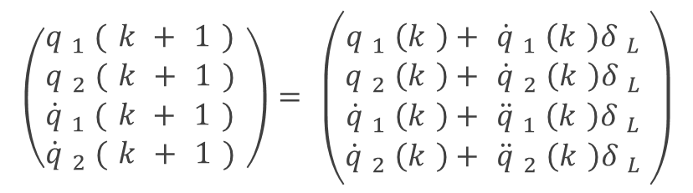
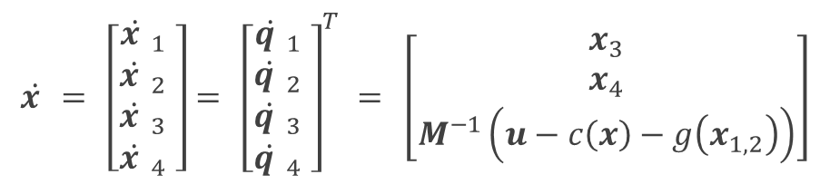
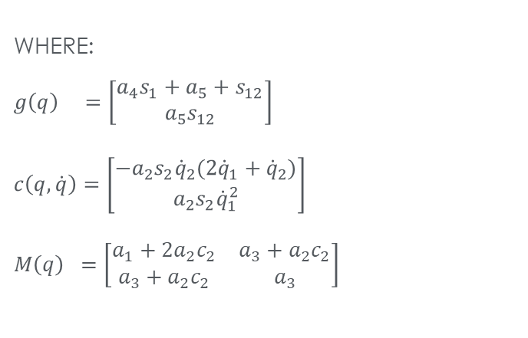
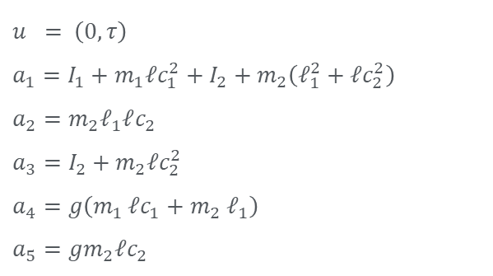
IMPLEMENTATION
Via pinocchio Library
ACROBOT DYNAMICS
$$\dot{x}=\left[\begin{aligned}{\dot{x}}_{1} \\ {\dot{x}}_{2} \\ {\dot{x}}_{3} \\ {\dot{x}}_{4}\end{aligned}\right]={\left[\begin{aligned}{\dot{q}}_{1} \\ {\dot{q}}_{2} \\ {\dot{q}}_{3} \\ {\dot{q}}_{4}\end{aligned}\right]}^{T}=\left[\begin{aligned}x_{3} \\ x_{4} \\ M^{−1}\left(u−c\left(x\right)−g\left(x_{1,2}\right)\right)\end{aligned}\right]$$
INPUT-STATE FORM OF DYNAMICS
$$\left(\begin{aligned}q_{1}(k+1) \\ q_{2}(k+1) \\ {\dot{q}}_{1}(k+1) \\ {\dot{q}}_{2}(k+1)\end{aligned}\right)=\left(\begin{aligned}q_{1}\left(k\right)+{\dot{q}}_{1}\left(k\right)δ_{L} \\ q_{2}\left(k\right)+{\dot{q}}_{2}\left(k\right)δ_{L} \\ {\dot{q}}_{1}\left(k\right)+{\ddot{q}}_{1}\left(k\right)δ_{L} \\ {\dot{q}}_{2}\left(k\right)+{\ddot{q}}_{2}\left(k\right)δ_{L}\end{aligned}\right)$$
DISCRETIZATION WITH
EULER INTEGRATION
WHERE:
$$g\left(q\right) =\left[\begin{aligned}a_{4}s_{1}+a_{5}+s_{12} \\ a_{5}s_{12}\end{aligned}\right]$$
$$c\left(q, \dot{q}\right)=\left[\begin{aligned}−a_{2}s_{2}{\dot{q}}_{2}(2{\dot{q}}_{1}+{\dot{q}}_{2}) \\ a_{2}s_{2}{\dot{q}}_{1}^{2}\end{aligned}\right]$$
$M\left(q\right) =\left[\begin{matrix}a_{1}+2a_{2}c_{2} & a_{3}+a_{2}c_{2} \\ a_{3}+a_{2}c_{2} & a_{3}\end{matrix}\right]$
$$u = \left(0, τ\right)$$
$$a_{1}=I_{1}+m_{1}ℓc_{1}^{2}+I_{2}+m_{2}\left(ℓ_{1}^{2}+ℓc_{2}^{2}\right)$$
$$a_{2}=m_{2}ℓ_{1}ℓc_{2}$$
$$a_{3}=I_{2}+m_{2}ℓc_{2}^{2}$$
$$a_{4}=g\left(m_{1 }ℓc_{1}+m_{2}{ ℓ}_{1}\right)$$
$$a_{5}=gm_{2}ℓc_{2}$$

Slide 6
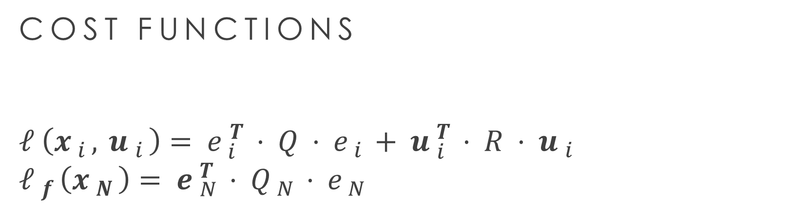
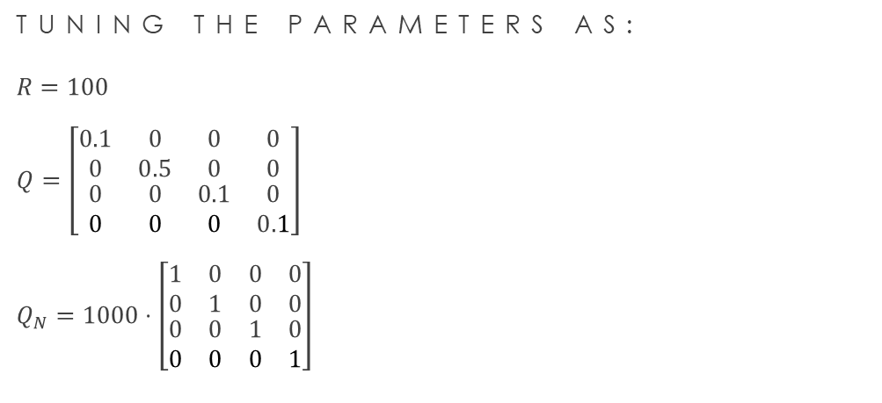
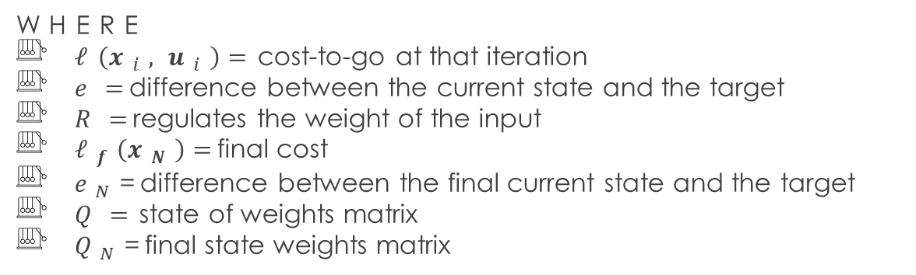
COST FUNCTIONS
$$ℓ\left(x_{i},u_{i}\right)=e_{i}^{T}⋅Q⋅e_{i}+u_{i}^{T}⋅R⋅u_{i}$$
$$ℓ_{f}\left(x_{N}\right)=e_{N}^{T}⋅Q_{N}⋅e_{N}$$
IMPLEMENTATION
TUNING THE PARAMETERS AS:
$$R=100$$
$$Q=\left[\begin{matrix}0.1 & 0 & 0 & 0 \\ 0 & 0.5 & 0 & 0 \\ \begin{aligned}0 \\ 0\end{aligned} & \begin{aligned}0 \\ 0\end{aligned} & \begin{aligned}0.1 \\ 0\end{aligned} & \begin{aligned}0 \\ 0.1\end{aligned}\end{matrix}\right]$$
$$Q_{N}=1000⋅\left[\begin{matrix}1 & 0 & 0 & 0 \\ 0 & 1 & 0 & 0 \\ \begin{aligned}0 \\ 0\end{aligned} & \begin{aligned}0 \\ 0\end{aligned} & \begin{aligned}1 \\ 0\end{aligned} & \begin{aligned}0 \\ 1\end{aligned}\end{matrix}\right]$$
WHERE
$ℓ\left(x_{i},u_{i}\right)=$cost-to-go at that iteration
$e=$difference between the current state and the target
$R=$regulates the weight of the input
$ℓ_{f}\left(x_{N}\right)=$final cost
$e_{N}$=difference between the final current state and the target
$Q=$state of weights matrix
$Q_{N}$=final state weights matrix

Slide 7
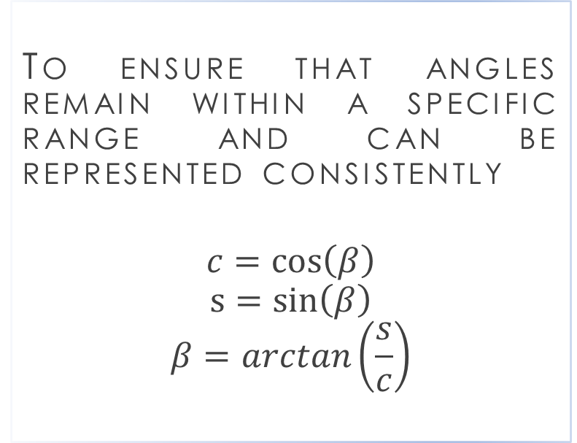
ANGLE WRAPPING AND INITIAL GUESS
ANGLE WRAPPING
INITIAL GUESS
To ensure that angles remain within a specific range and can be represented consistently
$$c=\cos\left(β\right)$$
$$s=\sin\left(β\right)$$
$$β=arctan\left(\frac{s}{c}\right)$$
Null: without generating motion; greater number of iterations (in this case 821).
Sinusoidal: idea born observing the swing-up movement; convergence with ≈200 iterations less.
IMPLEMENTATION

Slide 8
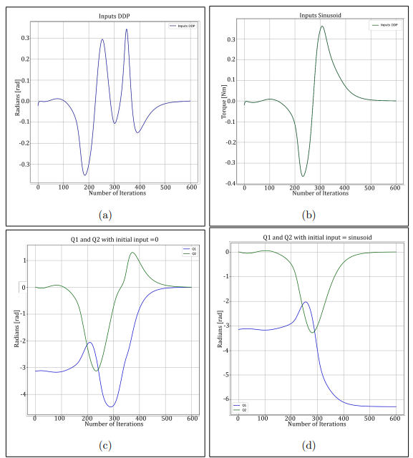
BACKWARD & FORWARD PASS
In the present plots, the comparison of the inputs and the trajectories generated by iLQR are reported.
IMPLEMENTATION
Inputs with a null initial input
Inputs with a sinusoidal initial input
trajectory with a null initial input
trajectory with a sinusoidal initial

Slide 9
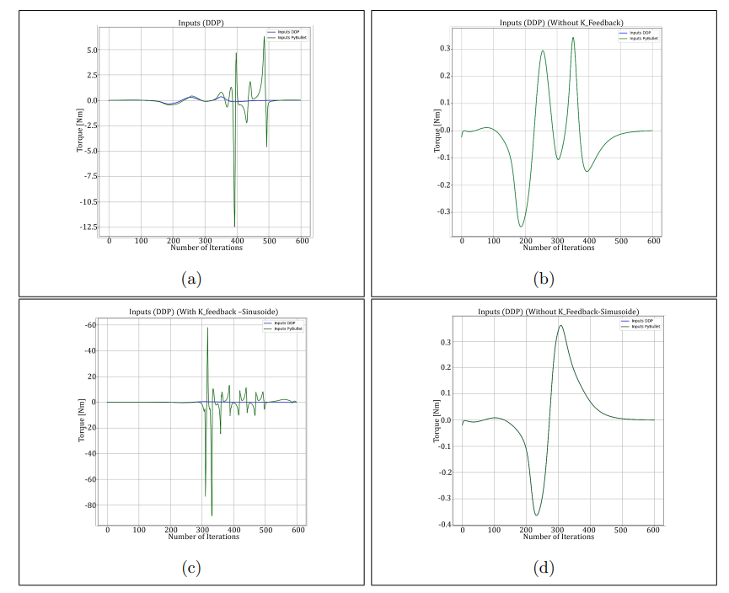
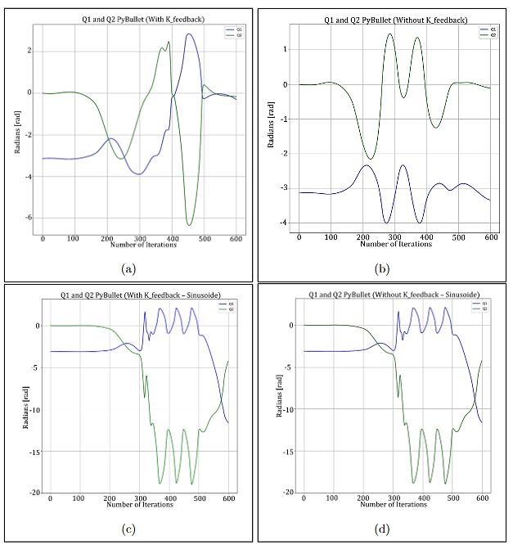
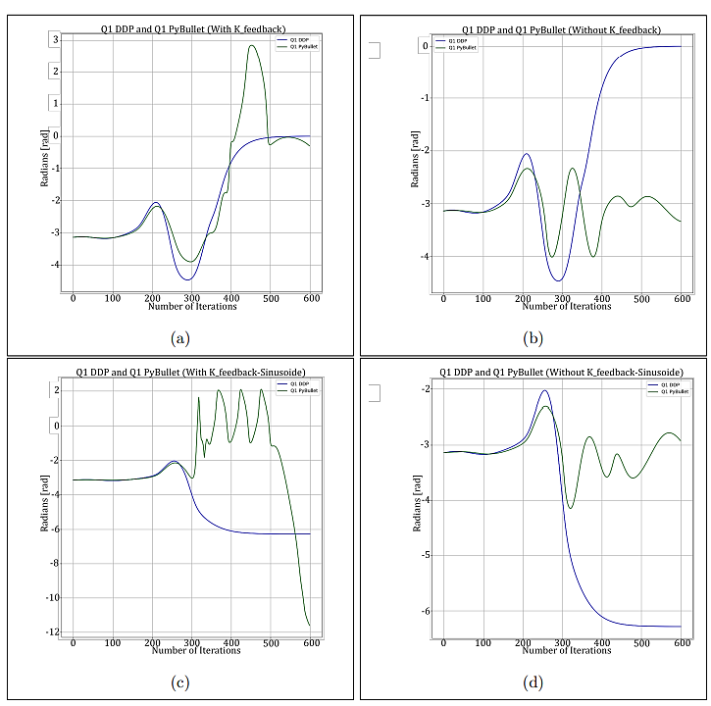
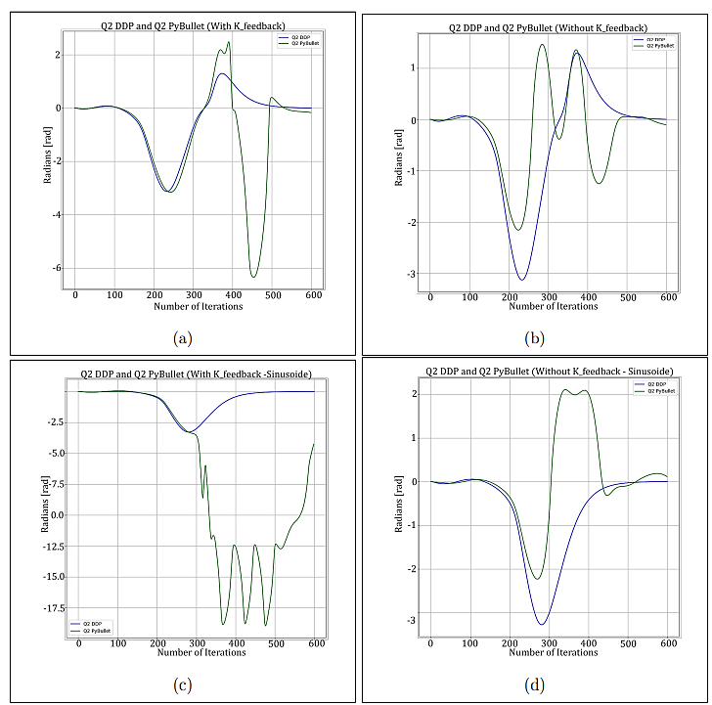
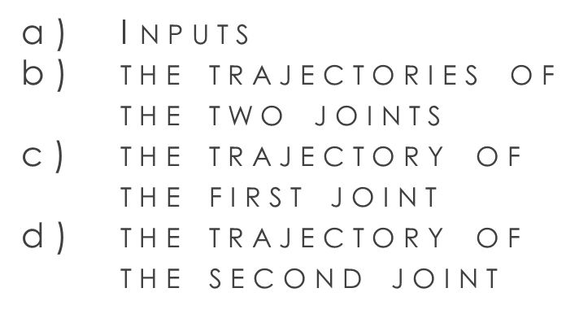
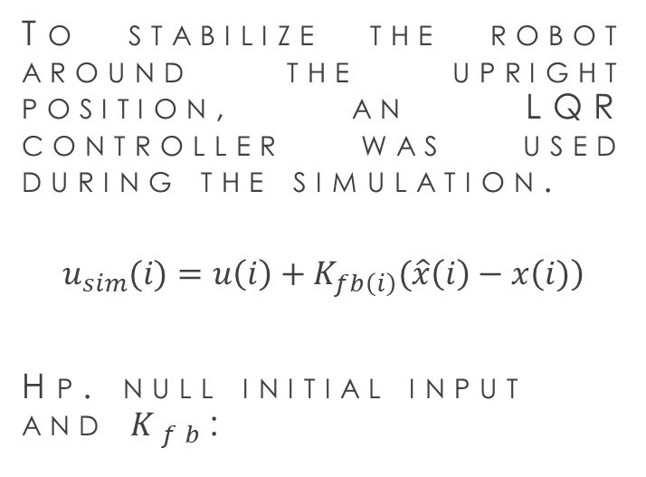
SIMULATION
To stabilize the robot around the upright position, an LQR controller was used during the simulation.
$$u_{sim}(i)=u\left(i\right)+K_{fb\left(i\right)}(\hat{x}\left(i\right)−x\left(i)\right)$$
Hp. null initial input and $K_{fb}$:
(a)
(b)
Inputs
the trajectories of the two joints
the trajectory of the first joint
the trajectory of the second joint
(c)
(d)

Slide 10
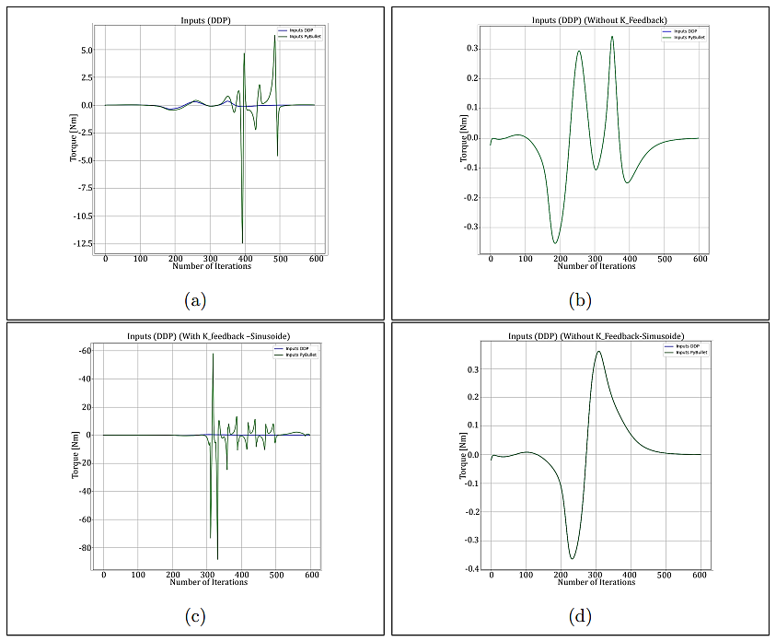
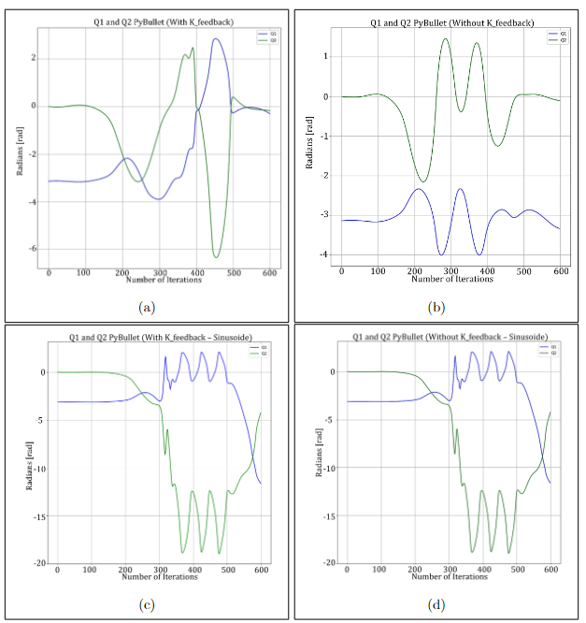
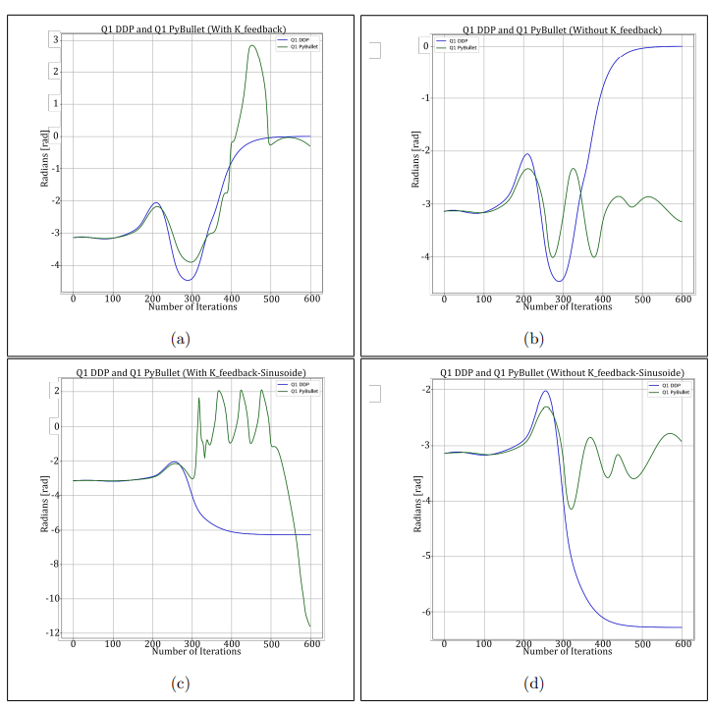
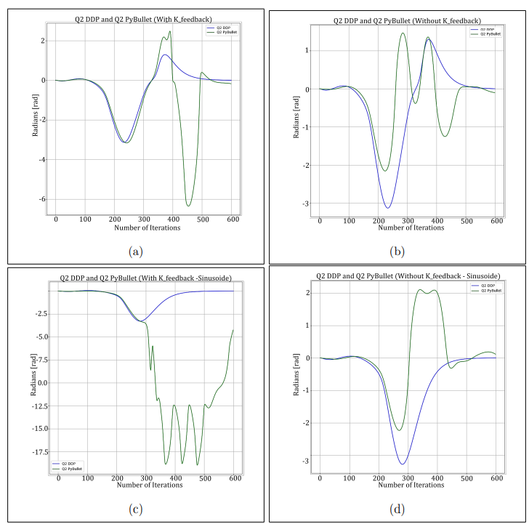
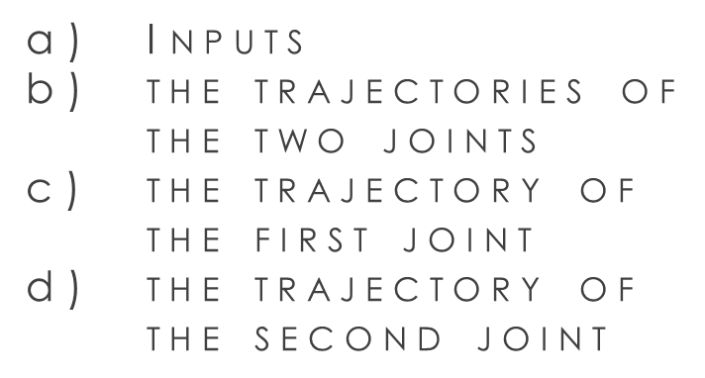

SIMULATION
Hp. null initial input, NO $K_{fb}$:
Inputs
the trajectories of the two joints
the trajectory of the first joint
the trajectory of the second joint
(a)
(b)
(c)
(d)

Slide 11
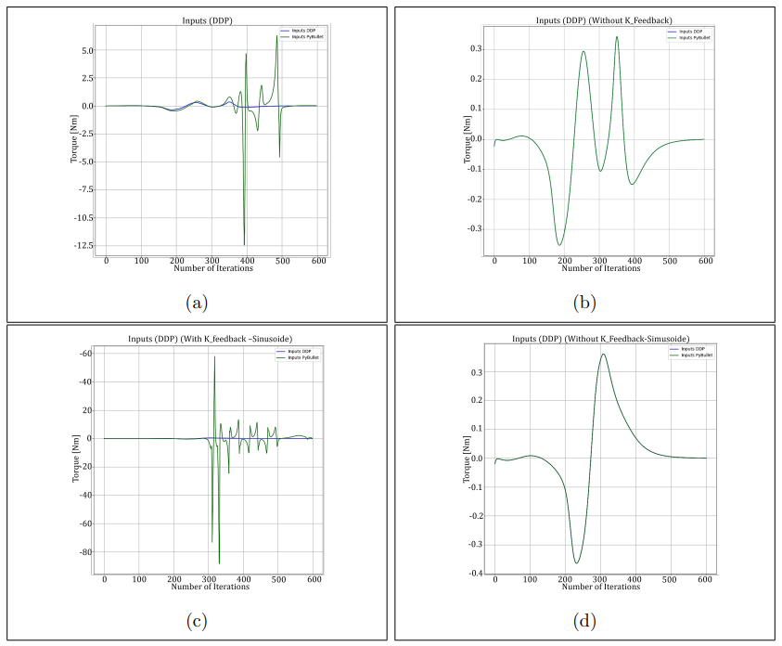

SIMULATION
Hp. Sinusoidal initial input, and $K_{fb}$:
Inputs
the trajectories of the two joints
the trajectory of the first joint
the trajectory of the second joint
(a)
(b)
(c)
(d)

Slide 12

SIMULATION
Hp. Sinusoidal initial input, NO $K_{fb}$:
Inputs
the trajectories of the two joints
the trajectory of the first joint
the trajectory of the second joint
(a)
(b)
(c)
(d)

Slide 13
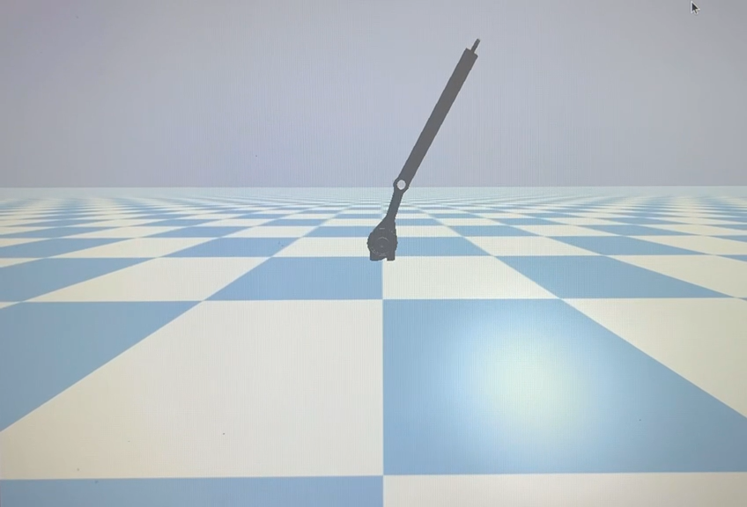
An optimised trajectory is achieved with iLQR.However:
It is highly dependent on cost functions
parameter tuning could determine the convergence
There’s a discrepancy between the convergence of the algorithm and what is obtained with PyBullet.
To overcome this problem, it can be used an MPC.
CONCLUSIONS
simulation movement in case of null initial input and a K Feedback term

Slide 14
THANK YOU FOR YOUR ATTENTION

